Slide 1





PaaS Azure SQL Architecture
Deep dive into Azure SQL deployment models, purchasing models, available service tiers and availability models
ZORAN BARAC, Principal Data Architect @ CIN7
zoran.barac.zof@gmail.com
blog.sqlserveronline.com
www.linkedin.com/in/zoran-barac/
www.meetup.com/Auckland-SQL-User-Group/

Slide 2


Thank You to our Sponsors!
Gold:
Please patronize our sponsors and thank them for sponsoring! We couldn’t run events like these without the support.

Slide 3

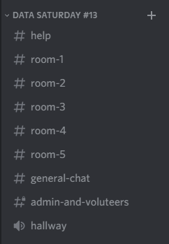

Join The PASSMN Discord Server
https://discord.gg/GajGTFVT28
We’re using Discord as our background chat and communication platform to augment our Virtual Events. This way you can chat with all attendees and continue the conversation after the sessions/event.
Note: Change your Nickname to your First & Last Name so it’s easier to know who you are.
Help Chat:
Session Chat & Q/A:
Example:
Voice Chat:

Slide 4
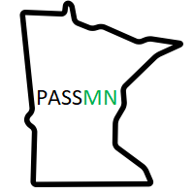




PASSMN
We’re always looking for speakers, sponsors, and new members. Contact us!
Minnesota Data and Analytics User Group Azure Data Tech Group Community Member
Meetup:
https://www.meetup.com/MN-SQL-Server-User-Group-PASSMN/
Email:
board@passmn.com
LinkedIn:
https://www.linkedin.com/groups/2034949/
Twitter:
@PASSMN - https://twitter.com/PASSMN
Code of Conduct:
https://passmn.com/code-of-conduct/

Slide 5
Agenda
Azure SQL PaaS
Azure SQL deployment models
Purchasing Models
Service Tiers
Availability Models
PaaS Azure SQL Architecture
Locally Redundant, Zone Redundant and GEO Redundant availability
Standard availability model
Basic, Standard, and General Purpose service tier locally redundant availability
General Purpose service tier zone redundant availability
Premium availability model
Premium and Business Critical service tier locally redundant availability
Premium and Business Critical service tier zone redundant availability
Read-only replicas and read-only query workloads
Hyperscale service tier architecture
Connectivity architecture for Azure SQL Managed Instance
Connectivity architecture for Azure SQL Database
GEO Redundant Architecture Azure SQL DB
DEMO

Slide 6
Azure SQL PaaS
Azure SQL deployment models
Purchasing Models
Service Tiers
Availability Models

Slide 7
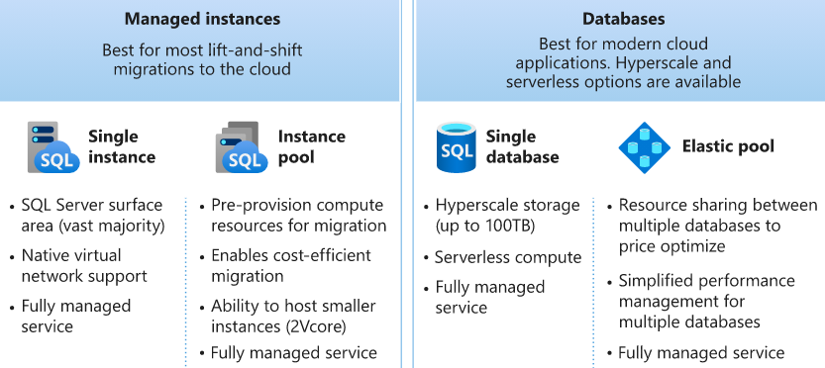
Azure SQL deployment models / options

Slide 8
Purchasing models and service tiers
DTU purchasing model (Azure SQL Database, Elastic Pool)
Service tiers options
Basic service tier - less demanding workloads, max 5DTU, max data size 2GB, R/W latency 5/10ms
Standard service tier - CPU-intensive workloads, 3000 DTUs (S12), max data size 1TB, R/W latency 5/10ms
Premium service tier - IO-intensive workloads, 1TB+ of storage (from P11 and up to P15), max data size 4TB, 4000 DTUs, R/W latency 2ms, read scale-out, zone redundant
vCore purchasing model (Azure SQL Database, Elastic Pool, Instance Pools, Managed Instances)
Service tiers options:
General Purpose - MI 4-80 vCores, 32GB-16TB, Azure DB up to 80 vCores, 408GB memory and max data size 4TB, Azure DB Serverless up to 40 vCores, up to 120GB memory and max data size 4TB
Business Critical - MI 4-80 vCores, 32GB-4TB, Azure DB up to 80 vCores, 408GB memory and max data size 4TB
Hyperscale - up to 80 vCores, 408GB memory and max data size 100TB

Slide 9
Availability models that are used in Azure SQL
Standard availability model that is based on a separation of compute and storage. It relies on high availability and reliability of the remote storage tier. This architecture targets budget-oriented business applications that can tolerate some performance degradation during maintenance activities.
Premium availability model that is based on a cluster of database engine processes. It relies on the fact that there is always a quorum of available database engine nodes. This architecture targets mission critical applications with high IO performance, high transaction rate and guarantees minimal performance impact to your workload during maintenance activities.

Slide 10
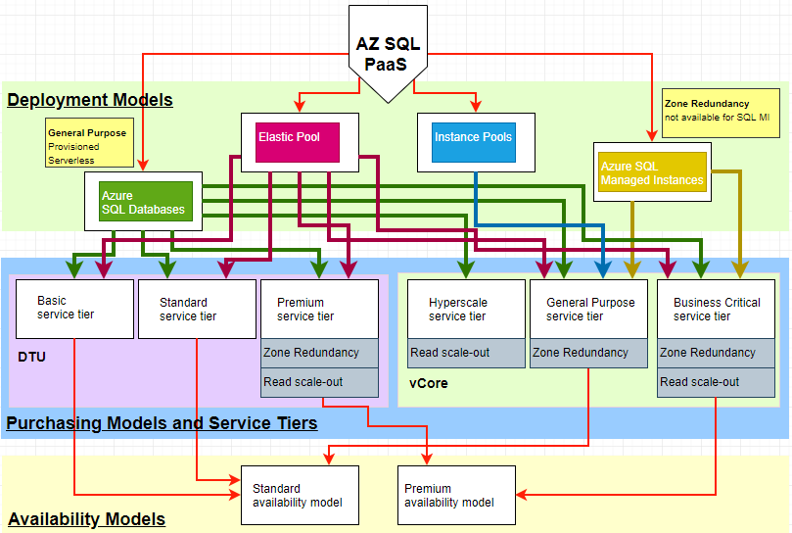

Slide 11
PaaS Azure SQL Architecture
Redundancy options
Standard availability model
Basic, Standard, and General Purpose service tier locally redundant availability
General Purpose service tier zone redundant availability
Premium availability model
Premium and Business Critical service tier locally redundant availability
Premium and Business Critical service tier zone redundant availability
Read-only replicas and read-only query workloads
Hyperscale service tier availability

Slide 12

AlwaysOn AG / SQL Server on Azure VM (IaaS)
Create a resource group
Create the network and subnet
Create availability sets (Fault Domain and Update Domain concepts)
Configure domain controller
Create 2 SQL Server VMs
Configure the SQL Server VMs (Choose appropriate VM size, Select a SQL Server VM image, Appropriate drives, Grant appropriate permissions, Set SQL Server service accounts, etc)
Join the servers to the domain
Add Failover Clustering features to both SQL Server VMs
Create the cluster
Add the SQL Servers to the cluster
Enable availability groups on both VMs
Create the availability group
Create an Azure load balancer
Configure the listener
Create configure Azure Storage Account Witness (HA Witness);
Create credentials and setup backup jobs to Azure Storage Account;
Enable and configure TDE - Transparent Data Encryption (Create Master Key, Create Certificate protected by a master key, Create Database Encryption Key, Enable Encryption, Backup Certificate);
Etc

Slide 13
Locally Redundant, Zone Redundant and GEO Redundant availability
Locally redundant availability
Depending on which service tiers you deployed it may leverage Standard Availability Architecture for Basic, Standard, and General purpose service tiers or Premium Availability Architecture for Premium and Business Critical service tiers
Zone redundant availability
This configuration utilizes Azure Availability Zones to replicate databases across multiple physical locations within an Azure region.
GEO redundant availability
Geo-replication is an Azure SQL Database business continuity and disaster recovery feature (Asynchronous replication)
Failover groups (FOG)

Slide 14
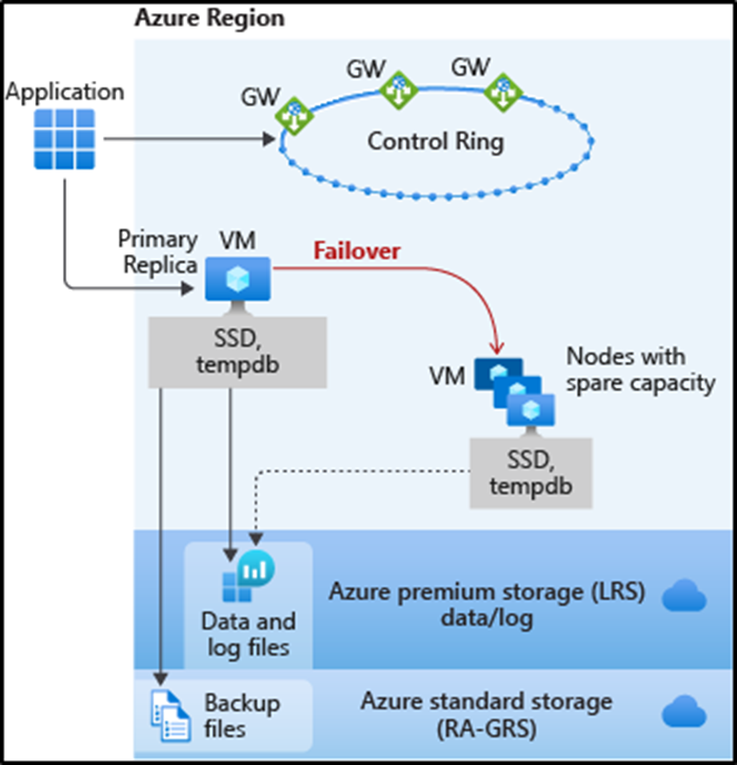
Basic, Standard, and General Purpose service tier locally redundant availability
The standard availability model includes two layers:
Compute layer that runs the sqlserver.exe process (contains only transient and cached data on the attached SSD, such as TempDB, model database, plan cache, buffer pool ).
Data layer with the database files (.mdf/.ldf) that are stored in Azure Blob storage. Azure blob storage has built-in data availability and redundancy feature.
Azure Service Fabric initializes sqlservr.exe, controls health of the node, and performs failover to another node if necessary.

Slide 15
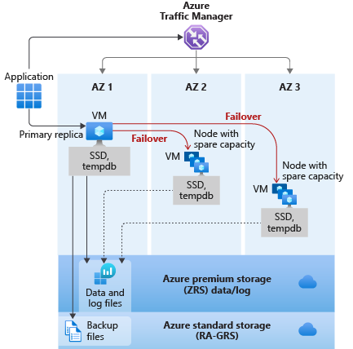
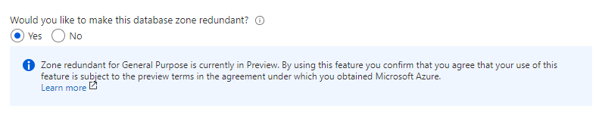
General Purpose service tier zone redundant availability
Notes:
For General Purpose tier, zone redundancy incurs an additional cost.
Zone redundant configuration for serverless and provisioned general purpose tier is only available in some regions.
Zone redundant for General Purpose is currently in Preview.
Zone redundant configuration is only available when the Gen5 compute hardware is selected.

Slide 16
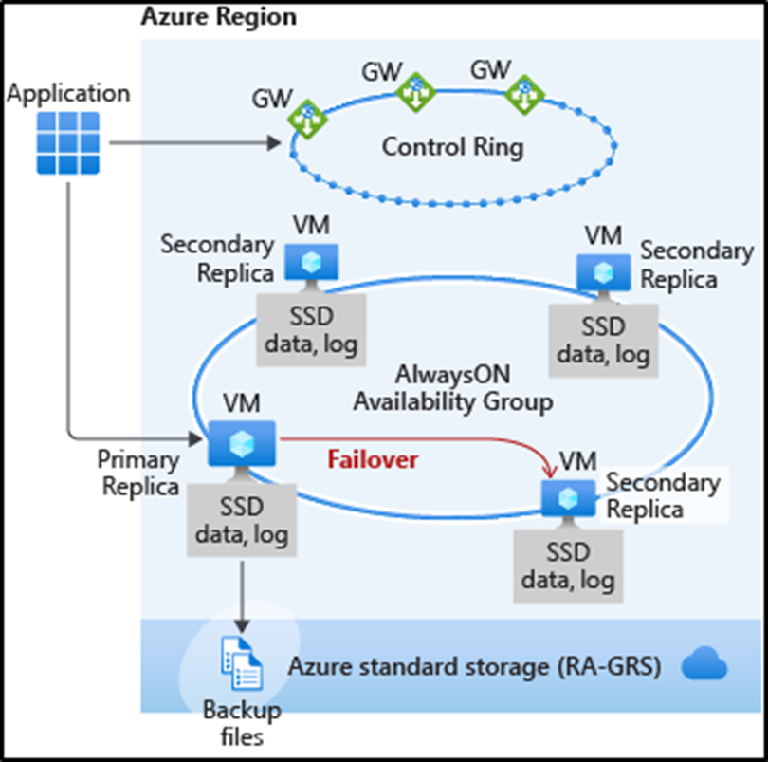
Premium and Business Critical service tier locally redundant availability
Business Critical service tiers leverage the Premium availability model, which integrates compute resources (SQL Server Database Engine process) and storage (locally attached SSD) on a single node.
High availability is achieved by replicating both compute and storage to additional nodes creating a three to four-node cluster.
Azure Service Fabric initializes sqlservr.exe, controls health of the node, and performs failover to another node if necessary.

Slide 17
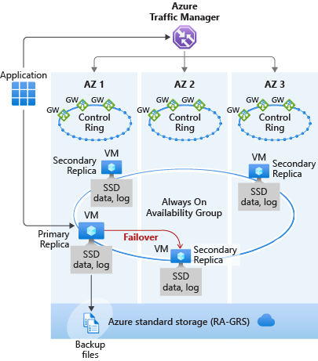
Premium and Business Critical service tier zone redundant availability
Performance impact - Zone redundant databases have replicas in different datacenters with some distance between them, the increased network latency may increase the commit time and affect the performance of some OLTP workloads.
Note
This feature is not available in SQL Managed Instance.

Slide 18
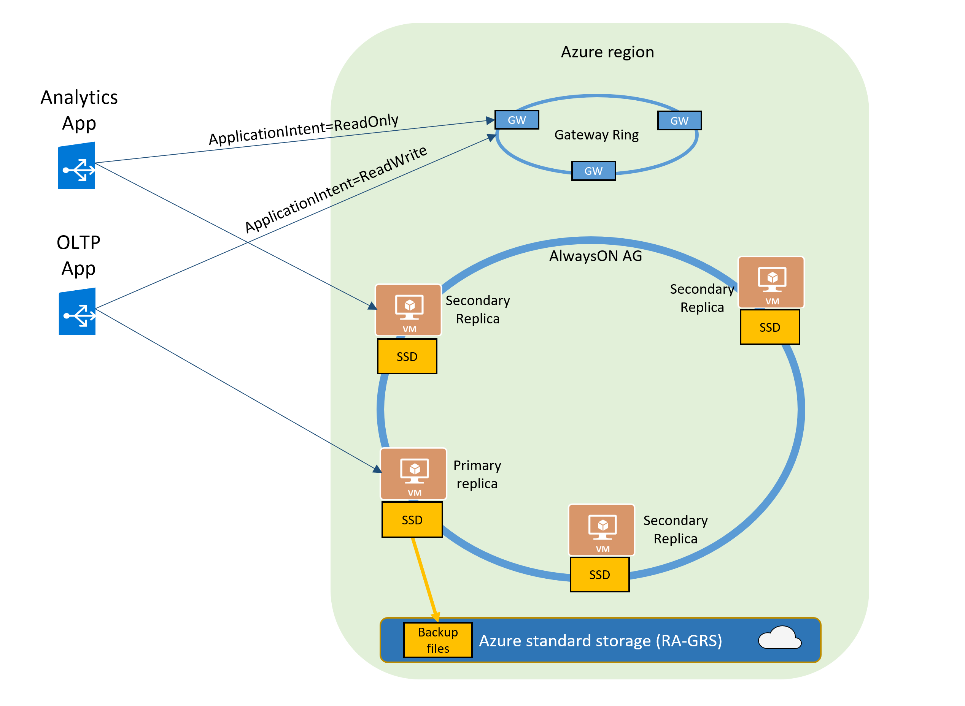
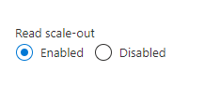
Read-only replicas and read-only query workloads
The Read Scale-Out feature is enabled by default on new Premium, Business Critical, and Hyperscale databases.
In case of Azure SQL Managed Instance it will be Business Critical service tier.
If your SQL connection string is configured with ApplicationIntent=ReadOnly, the application will be redirected by the gateway to a read-only replica of that database.

Slide 19
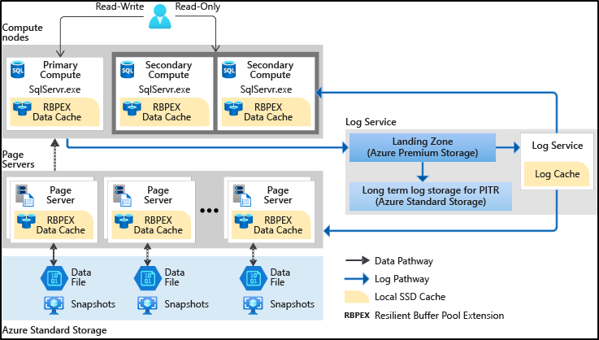
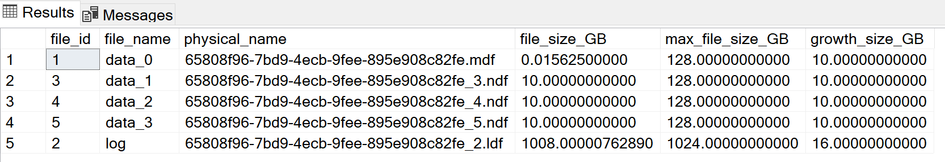
Hyperscale service tier availability
Most business workload, Autoscaling storage size up to 100 TB, fast vertical and horizontal compute scaling,
Fast database backup and restore,
Multiple replicas, up to 4 Read Scale-out,
Hyperscale is a multi-tiered architecture with caching at multiple levels,
Notes:
Note
Once a database is migrated to Hyperscale, it can't be migrated directly to a non-Hyperscale service tier.

Slide 20
PaaS Azure SQL Connectivity Architecture
Connectivity architecture for Azure SQL Managed Instance
Connectivity architecture for Azure SQL Database
GEO Redundant Architecture Azure SQL DB

Slide 21
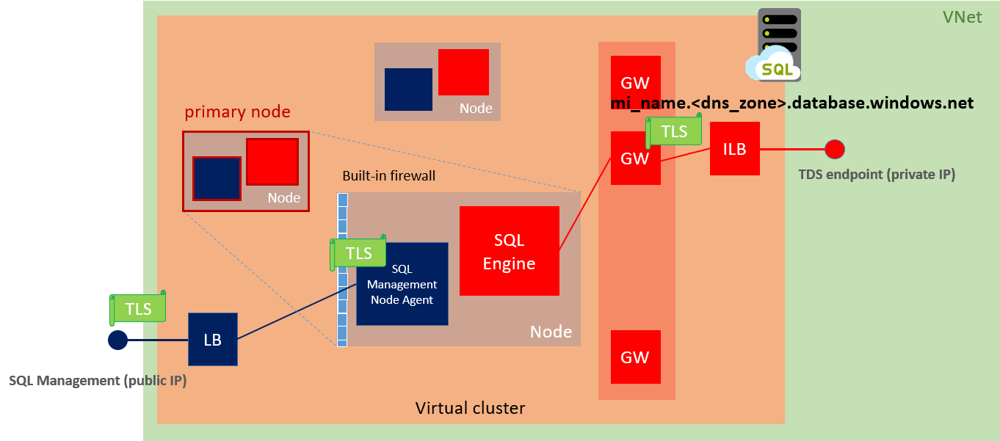
Virtual cluster connectivity architecture SQL MI

Slide 22
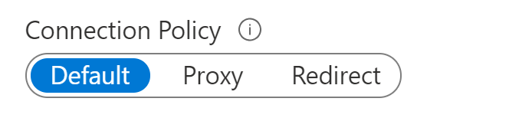
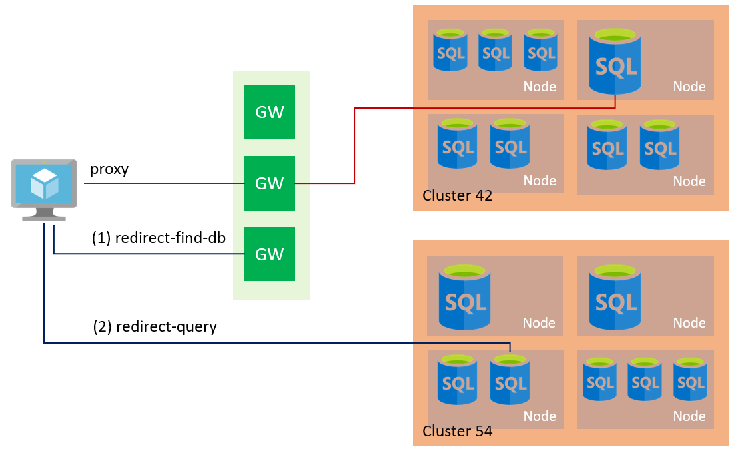
Azure SQL Database connectivity architecture
Redirect: Clients establish connections directly to the node hosting the database.
Proxy: In this mode, all connections are proxied via the Azure SQL Database gateways.
Default: The default policy is Redirect for all client connections originating inside of Azure (Azure Virtual Machine) and Proxy for all client connections originating outside (local workstation).

Slide 23
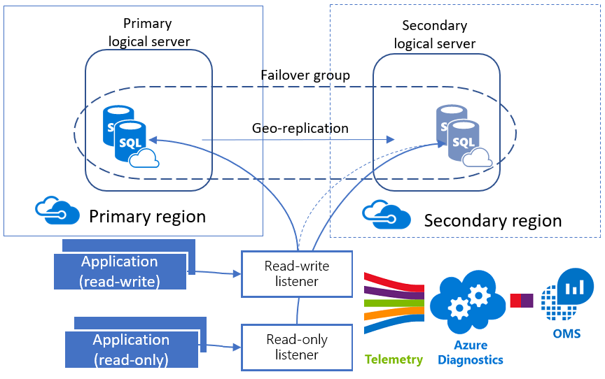
GEO Redundant Architecture Azure SQL DB

Slide 24
Summary

Slide 25
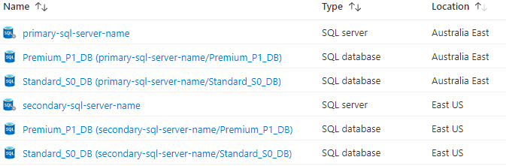
Demo
DATABASE S0 - STANDARD SERVICE TIER (DTU)
LOCALLY REDUNDANT AVAILABILITY - PRIMARY SQL SERVER ENDPOINT (-ReadOnly )
GEO REDUNDANT AVAILABILITY – FAILOVER GROUP R/W LISTENER
DATABASE P1 - PREMIUM SERVICE TIER (DTU)
LOCALLY REDUNDANT AVAILABILITY - PRIMARY SQL SERVER ENDPOINT (-ReadOnly )
GEO REDUNDANT AVAILABILITY - FAILOVER GROUP R/W LISTENER

Slide 26
Q&A
ZORAN BARAC, Principal Data Architect @ CIN7
MCT, MCSE
zoran.barac.zof@gmail.com
blog.sqlserveronline.com
www.linkedin.com/in/zoran-barac/
www.meetup.com/Auckland-SQL-User-Group/

